Slide 1

WP3
STREAM
Micro-credentials framework
Flavia Spizzichino
Tiziana Piacentini

Slide 2
AGENDA
General information
Workplan
Milestones, deliverables and deadlines
Highlights from the evaluation

Slide 3
General Information
Starting date: October 2024
Foreseen ending date: November 2026
WP leader: Ciofs-fp ETS
WP co-leader: VAVM
______________________________________________________
Based on the information gathered in the previous work package through research and the creation of the Blueprint, this work package will focus on the concrete construction of various components of the Micro-credential Framework, operating under the working title "The European Professional Certificate for Practitioners in Inclusive, Digital and Green Work-Based Learning."

Slide 4
General Information
Specifically, this includes:
Designing the training program to acquire necessary skills,
building the Micro-credentials of Stream system,
designing and issuing digital badges certifying the possession of skills
planning and implementing the online training delivery platform
creating an accreditation system to make the Stream-created system compatible with European credit certification systems such as EQF and ECTS.

Slide 5
WP Tasks

Slide 6
Wp Tasks
Task 3.1
STREAM Training plans
Task 3.2
Micro-credential framework design
Task 3.3
STREAM badges
Task 3.4
STREAM Learning Management System
Task 3.5
STREAM ACCREDITATION
Define the actual content of the training
Design the framework featuring all the European standard elements
Establish the criteria for obtaining the badge and design each badge
The LMS will host 3 training modules linked to the 3 clusters of Micro-credentials and each module will be delivered in the 5 pilot local versions
Assess and accredit the STREAM framework against EQF

Slide 7
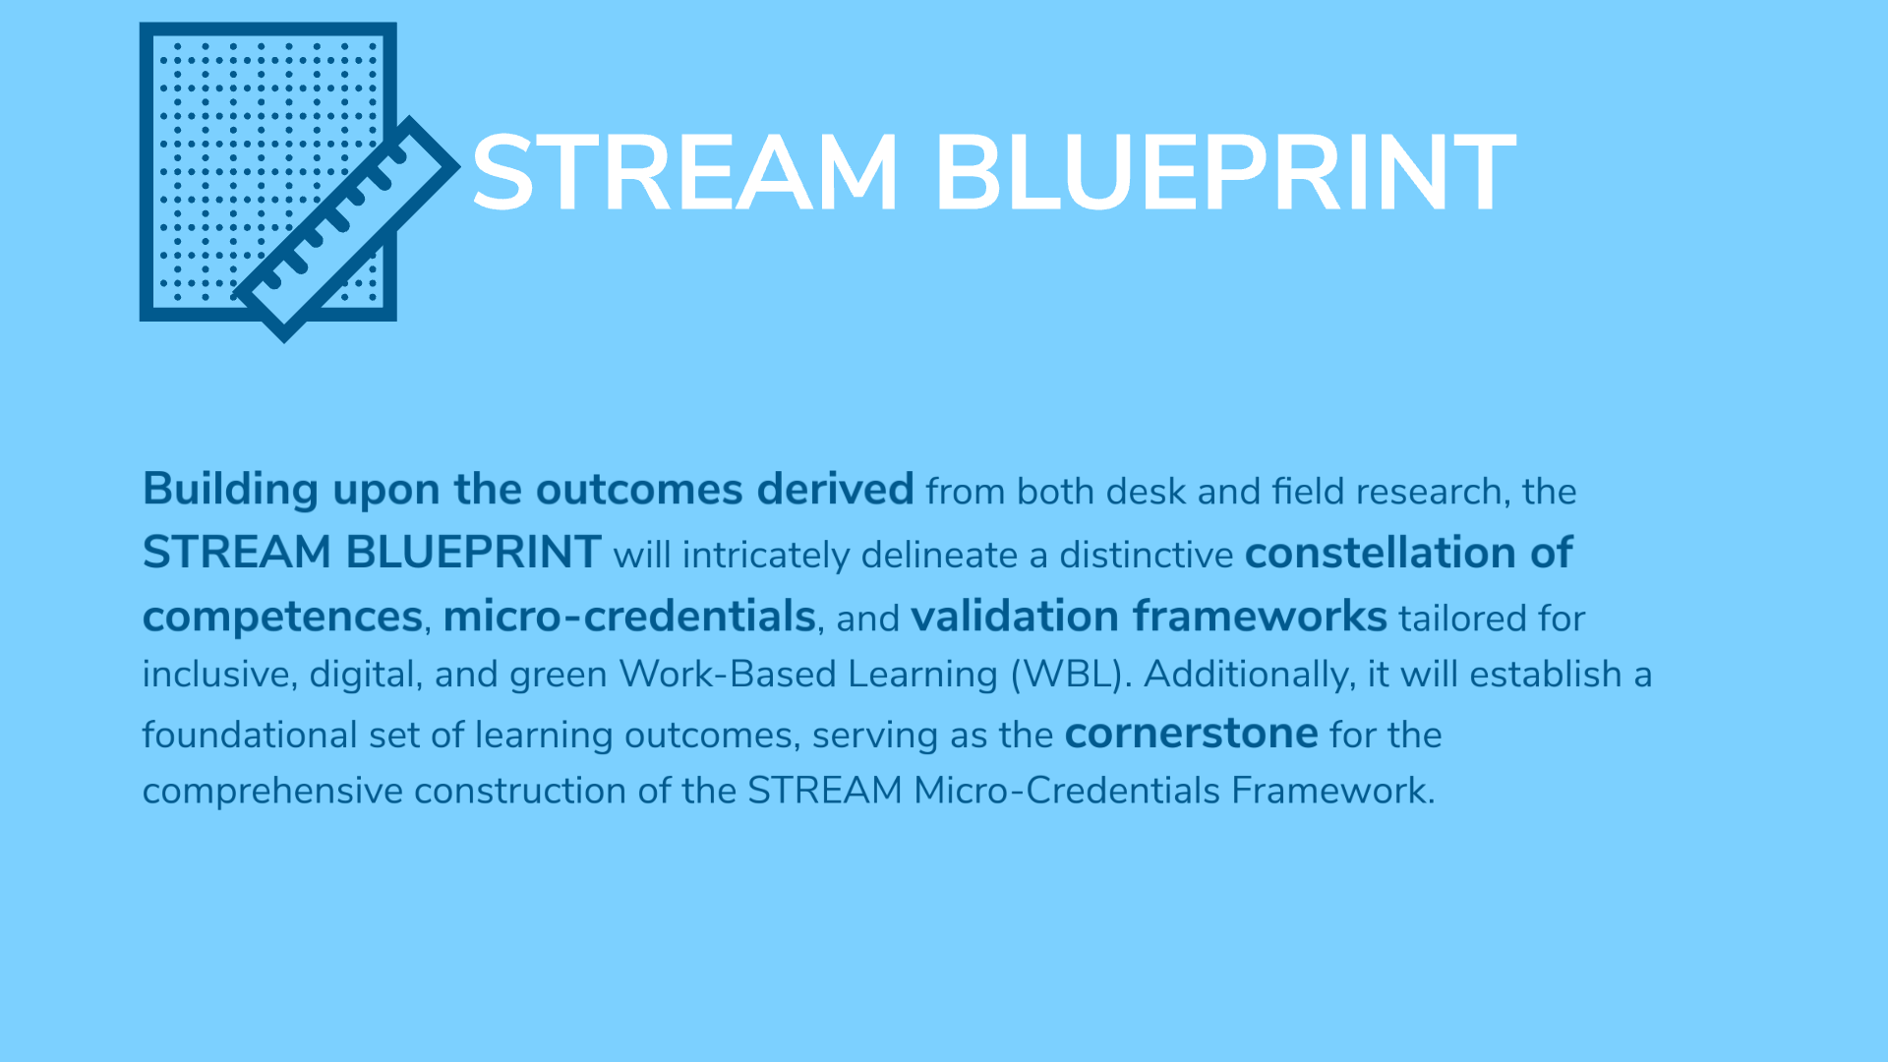
From WP2 to WP3
Building upon the outcomes derived from both desk and field research, the STREAM BLUEPRINT will delineate a distinctive constellation of competences tailored for inclusive, digital, and green Work-Based Learning (WBL).

Slide 8
Task 3.1 STREAM Training Plans
Following the design of the STREAM microcredential Blueprint developed in WP2, this task aims to define the actual content of the training in terms of:
• learning outcomes
• learning materials
• notional workload needed to achieve the learning outcomes
• definition of the delivery method and tools (eg. Choose of the Learning management system platform)
• design of the Assessment framework, with transparent and clearly defined criteria
The content of the training will be produced in IT, EL, ES, Lit, and ENG and adapted to the local context.
The plans will be definitively shared and approved during the III TPM AT M15

Slide 9
Task 3.2 STREAM Micro-credential framework design
All the information collected in the Blueprint and organized in the Training Plan will be used to design the STREAM Micro-Credential system aligned with European standards, as outlined in the Council Recommendation of June 16th, 2022
Key elements include:
ECTS credits (where applicable): Tailoring to local contexts for credit recognition.
EQF/QFEHEA level (if applicable): Defining the learning experience level.
Quality assurance: Utilizing WP3's digital badge system for verification.
Enrollment prerequisites: Establishing criteria to inform WP4's recruitment process.
Integration/stackability: Exploring options for combining STREAM credentials and recognizing prior learning (RPL).
Final approval of the STREAM Micro-Credential framework will occur during the Training and Microcredential Workshop at the III TPM in Vilnius (M15).

Slide 10
Task 3.3 STREAM badges design and implementation
Simultaneously with the previous tasks, the partners will agree on the STREAM digital badge framework by determining which skill or achievement to recognize for each microcredential.
Through collaboration, partners will define:
Badge award criteria: Clear requirements for earning each badge.
Badge design: Visually appealing and informative representations of acquired skills.
This ensures:
Seamless integration with C-BOX: Issuer partners can easily upload badge metadata.
Efficient verification and issuance: Streamlined process for verifying WBL completers and awarding badges based on established criteria.
Each learner will receive their badge in their own language

Slide 11
Task 3.4 - STREAM Learning Management System (LMS)
Starting in Month 13 (M13), we will implement a comprehensive LMS platform
This platform will house the three STREAM training modules:
Inclusive Competencies
Digital Competencies
Green Competencies
Each module will be available in 5 local versions and languages:
Italian (IT)
Irish (EN)
Greek (EL)
Spanish (ES)
Lithuanian (LT)

Slide 12
Task 3.4 - STREAM Learning Management System (LMS)
FU and FHM CPD bring expertise in accreditation and awarding bodies:
They offer professional qualifications for training and development staff.
They are licensed to award ECTS points for designed qualifications.
Accreditation Process:
Upon completion of framework development, FU and FHM will assess the STREAM framework against the European Qualifications Framework (EQF), targeting level 6.
They will also evaluate the Micro-credential Framework for compatibility with ECTS points, potentially allowing progression to broader professional Diplomas.
Alignment with European Standards:
This process aligns with the newly launched European Learning Model, ensuring proper description of learning opportunities, qualifications, credentials, and accreditations.

Slide 13
Milestones & deliverables Timeline
Work Package 3: STREAM Micro credentials framework
March 2025
aUGUST 2025
D. 3.1
STREAM Microcredential framework
(CIOFS-FP ETS)
D. 3.2
STREAM LMS
(CIOFS-FP ETS)
M. 3.1
Training and Microcredential WorkShop –
During the 3rd TP meeting
(VAVM)
M. 3.2
STREAM LMS release
(CIOFS-FP ETS)
D. 3.3
STREAM Badges
(CIOFS-FP ETS)

Slide 14
Highlights from the evaluation
Regarding the micro-credentials, the proposal bears in mind Europass, while the European Digital credentials for Learning are not included.
The proposal explains that an open access strategy will be adopted regarding the access of STREAM learning opportunities and tests by external participants. However, the proposal indicates that the commercialisation of project outputs will be discussed in the future.
While scalability is an apparent goal, no clear targets are presented. The proposal does not explain nor justify adequately potential fees for micro credentials services provided through the Virtual Networking Space

Slide 15
Other highlights
The STREAM Micro-credential Framework is expected to be aligned to EQF Level 6
A digital open badge “STREAM Ambassador “will be awarded to those who, having followed the project, will show interest in disseminating project’s outcomes. It will be an important promotional result as well because it will enhance the engagement of the target group and the sustainability of the project after its lifetime.

Slide 16
Thank you!
Flavia Spizzichino
Tiziana Piacentini

