Slide 1



STREAM - frameworks for validation, sustainability and exploitation
WP5 lead by MetropolisNet, co-lead by Assolombarda
Month 9 to 36 (Sep 2024 to Dec 2026)

Slide 2

Objectives Work Package 5 (WP5)
The exploitation actions in STREAM contribute to the overall goal to build
  a functional, credible and reliable MC system corresponding to the EU recommendations and indications,
  a sustainable and accredited occupational profile that successfully takes over defining and supporting VET professionals and institutions across Europe to plan, manage and assess agile and effective WBL, supporting VET learners in their inclusion and employment paths.
WP Objectives
strengthening the development and use of Micro-credentials in relation to national qualifications systems
strengthening VET organisations capacity to build and manage Micro-credentials

Slide 3
Target Groups
Companies
VET organisations (teachers and managers)
Public authorities

Slide 4
T5.1 Peer Expert Group building and management (MetNet)
Peer Experts Group (PEG) will be set up during the 2nd TPM in Madrid
Each partner organisation will designate one of its members to participate in the PEG. It has the role to review the project approaches and results from a scientific and policy perspective and to bridge them to thematic national and transnational interlocutors.
The research results will be the basis on which the PEG will give its contribution to the methodological guidelines and to the paper with recommendations for policy makers
Work of PEG will prepare the development of a Memorandum of Understanding (MoU) → D5.2

Slide 5
T5.2 Definition of STREAM Micro-credential framework user-friendly guidelines (MetNet)
As result of the WP3 and WP4 activities, a methodological guideline will be realised with the aim to share the steps followed to build the Stream Micro-credentials System and give practical information and support to practitioners and managers interested in building a micro-credentials system.
The methodological guideline will be prepared by MetNet (WP leader) supported by Ciofs-fp ETS (WP3 leader) and it will be supervised by the Expert group → D5.1
The methodological guideline will be translated in all partners languages and it will be disseminated in each local networking event foreseen in WP6 (Impact, dissemination, capitalisation) and during the final conference.

Slide 6
T5.3 Local networking workshops (Assolombarda)
Local networking workshops to discuss the Stream Micro-credentials System with relevant stakeholders: companies, VET organisations and Public authorities
2 per piloting country = 10 workshops in total
Each Workshop lasts for 3 hours and has 15/20 participants
→ MS 12

Slide 7
Deliverables and Milestones
Deliverable N° | Deliverable name | Description | Leader | Deadline | Dissemnation level
D5.1 | STREAM Microcredential framework userfriendly guidelines | The user-friendly guidelines will be drafted in English and translated in Italian, Spanish, Lithuanian and Greek | MET | September 2026 | Public
D5.2 | Memorandum Of Understanding | The document will be in English | Assolombarda | December 2026 | Public
Milestone N° | Milestone name | Description | Leader | Participants | Deadline | Means of verification
MS12 | Local networking workshops | Local networking workshops to discuss the Stream Micro-credentials framework with relevant stakeholders | Assolombarda | All | From September 2025 to December 2026 | Participants’ list Photos Meeting minutes

Slide 8
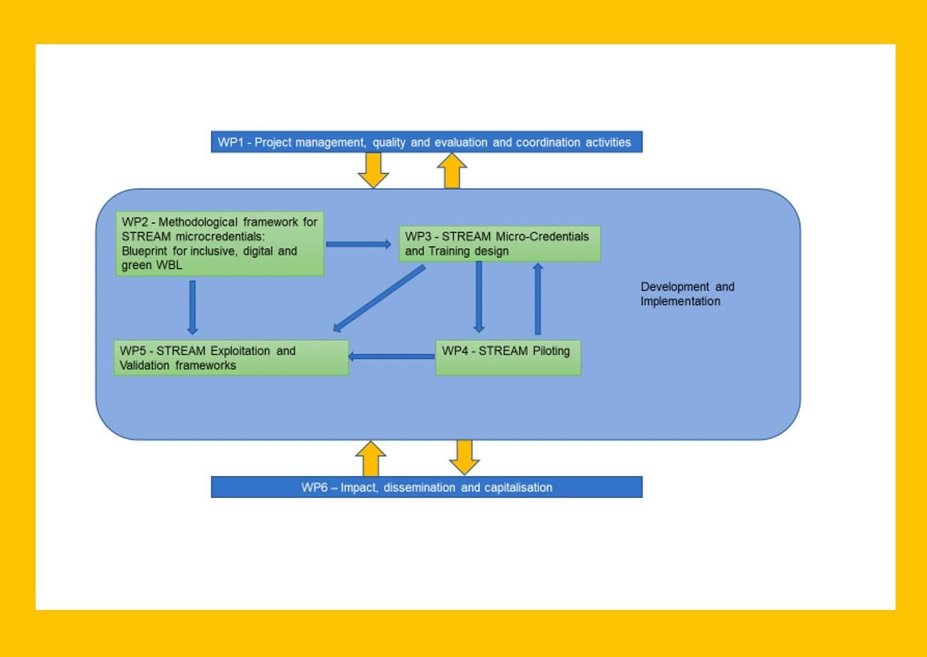

Slide 9
Peer Expert Group
D.2.2 Blueprint
(Rinova, CECE)
The PEG will comprise experts on VET systems, competences accreditation and recognition, learning assessment, scientific research and evaluation with the role to review the project approaches and results from a scientific and policy perspective and to bridge them to thematic National and transnational interlocutors.
Tasks:
Gathers feedback from actions;
issues recommendations contributes to key deliverables in STREAM
validates deliverables and findings
D.5.1 User-friendly guidelines for STREAM MC
(Assolombarda, IDEC)
Connections with WPs:
> WP2 (Blueprint)
< WP 3/4 MC system and piloting
> WP6 capitalisation and dissemination
D.5.2 Memorandum of Understanding
(Assolombarda)
D.6.2 Paper on recommendations
(Assolombarda, Ciofs, all)

Slide 10

First exploitation activities
WP 6 starting in M9 – September 2024
2nd TPM in Madrid, September 2024
  Policy Recommendations Working session → start of the work on Paper on Micro-credentials validation – Recommendations for policy makers
  kicking of the Peer Expert Group
    First task of the PEG: plan own work program and timetable, accordingly to the exploitation and dissemination deliverables.
  Exploitation Strategy document is not foreseen but will be developed if useful

Slide 11
Conclusion
Validation, sustainability and exploitation in STREAM is of high importance → Work Package running in parallel for 27 months
Memorandum of Understanding signed by all Consortium members - envisages all the relevant agreements to systematize, adapt and adopt the STREAM MC after the end of the project
Good basis for engagement of further institutions in our framework, as well as insurance for new learners to engage in it.

Slide 12

Thank you !

