Slide 1


STREAM Blueprint for inclusive, digital and green Work Based Learning (WBL)
WP2 lead by RINOVA, co-lead by CECE
Month 2 to 9 (Feb to Sep 2024)

Slide 2


Objectives Work Package 2 (WP2)
The blueprint acts as a roadmap for the development of the micro-credential framework. It provides an initial structured plan and guidelines for co-creating a comprehensive and effective certification system.
Identification of the characteristics and application of micro credentials in VET in the 5 partnership countries
Identification of micro-competencies on which to built the Stream micro-credential System
Target Groups
VET staff and companies involved in WBL/international mobilities
Aim to impact VET relevance and proximity to the labor market

Slide 3
Three Clusters of Competences (and badges)
1. Inclusive Competencies
- Focus on inclusion, intercultural/cross-cultural, and intersectional competencies
- Applied in international WBL mobilities
2. Digital Competencies
- Digital skills related to the digital transformation of WBL and international mobilities
- Reference to DigiComp
3. Green Competencies
- Ensure environmental sustainability in WBL and international mobilities
- Reference to GreenComp
Recognition through a micro-credential and Digital Competence badges

Slide 4
T2.1 Desk research (led by Rinova)
Partners will conduct desk research to begin co-creating and:
1. recognise validation frameworks of informal and non-formal competences
2. Micro-credentials use and frameworks
3. competences frameworks and quality standards in inclusive WBL
Research will be conducted in Italy, Spain, Ireland, Lithuania and Greece.
Based on research results, the project will place the STREAM micro credentials against the national qualification systems, suggesting possible steps to bridging or narrowing the gap (see WP 3, WP 5 AND WP 6).
To this purpose, national regulations, laws, public paper and documents will be collected and commented in country reports. Partners will be provided with an outline for the construction of the country reports.

Slide 5
T2.2 Field Research (Led by CECE)
The field research component, involves stakeholders like trainers, learners, and companies. It ensures that the perspectives and needs of these key stakeholders are considered, making the resulting framework more relevant and practical. It helps in refining the competences based on real-world insights and also assuring quality.
Focus on defining competences constellation and framework
Involves interviews and focus groups with stakeholders: trainers, learners, and companies
20 people per country, minimum of 4 per stakeholder type

Slide 6
T2.3 Build the Blueprint (led Rinova)
Based on field research results, a set of learning contents will be selected to build on them the micro credentials.
The blue print will contain the elements to be followed for the construction of training plans and micro-credentials. It will map competences, Micro-credentials and validation frameworks.
Rinova and CECE will build the blueprint draft that will be revised and finalized with all partners at the “Blueprint workshop” at 2nd TPM (Milestone 7 – Month 9)
Blueprint final version will be the basis to build the training plan and the STREAM Microcredentials framework.

Slide 7
Deliverables
D2.1 Desk and Field research report (August 2024) Rinova & CECE
The report will collect and comment the 5 country reports It will be in English
D2.2 (Rinova and MetNet) Blueprint for inclusive, digital and green transnational WBL and mobilities (September 2024)
The blueprint will be a digital document in English

Slide 8
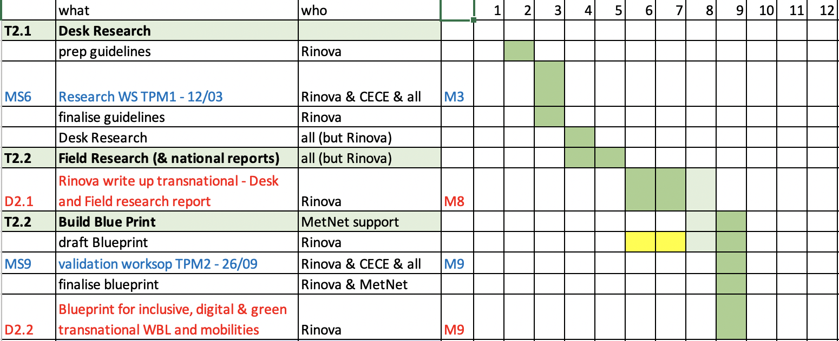
Calendar WP2

Slide 9
Desk & Field Research workshop at our Kick-Off Meeting in Rome
Facilitate by Rinova and CECE (Milestone 6 – month 2)
Dedicated working session to confirm the structure and main questions of the interview and focus groups
Ensures homogeneous information collection for country reports

